Slide 1
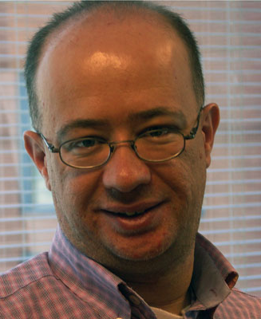
Community Detection in Political Twitter Networks using Nonnegative Matrix Factorization Methods
Mert Ozer
Nyunsu Kim
Hasan Davulcu

Slide 2
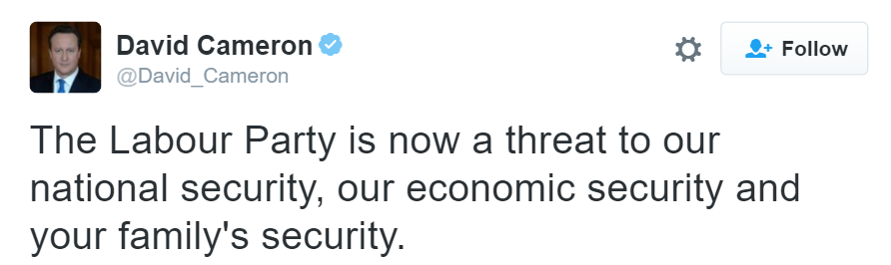
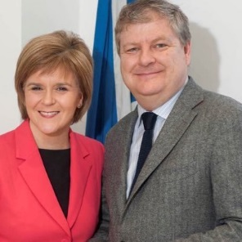
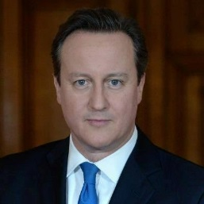
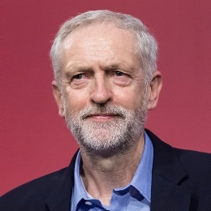
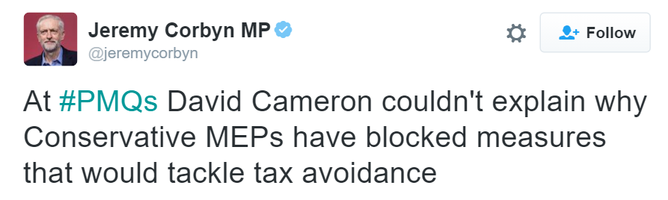
Motivation

Slide 3
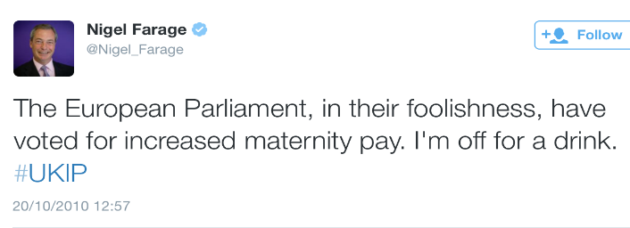
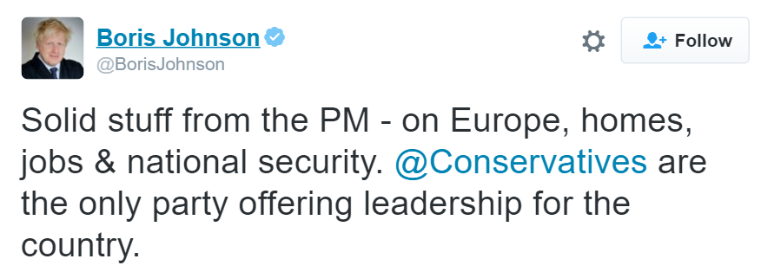
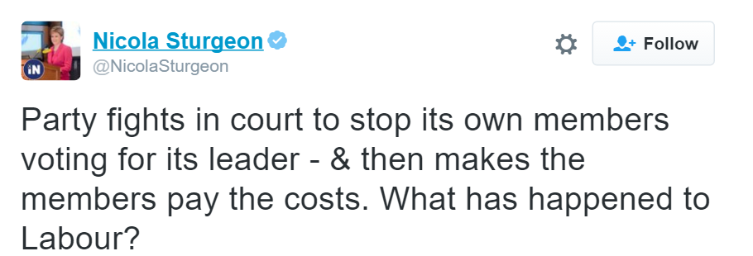
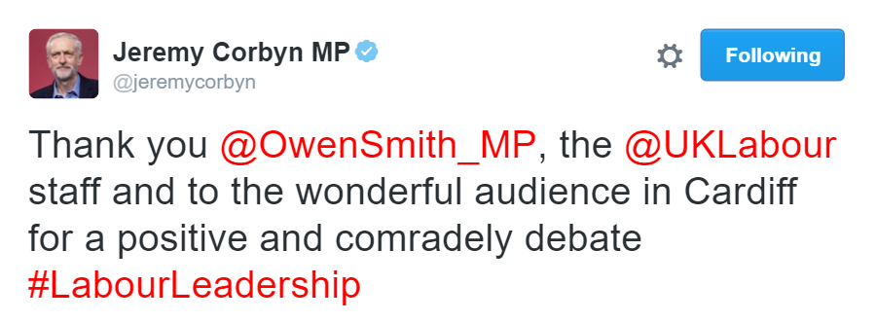
Motivation

Slide 4
Motivation

Slide 5
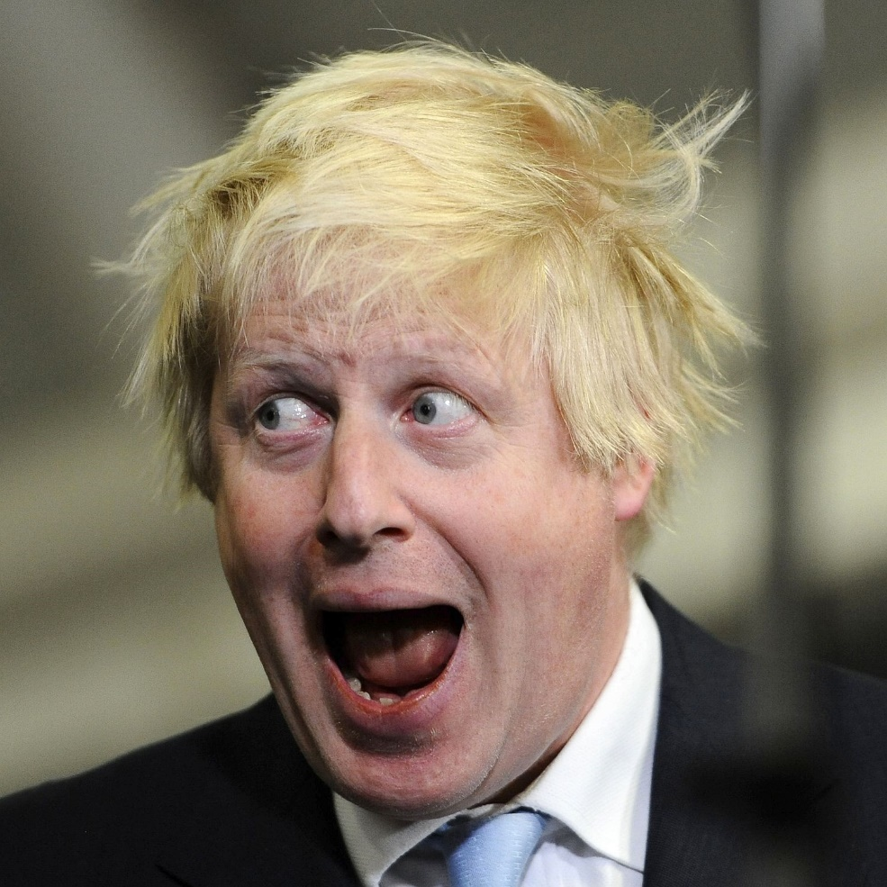
Motivation
Group Them?
Group Them?

Slide 6
Motivation
Jointly clustering connectivity and content of tweeters to detect latent group structures in political Twitter networks

Slide 7
Motivation
Jointly clustering connectivity and content

Slide 8
Motivation
Jointly clustering connectivity and content

Slide 9
Methodology
Jointly clustering connectivity and content
Security, national security, economic security…

Slide 10
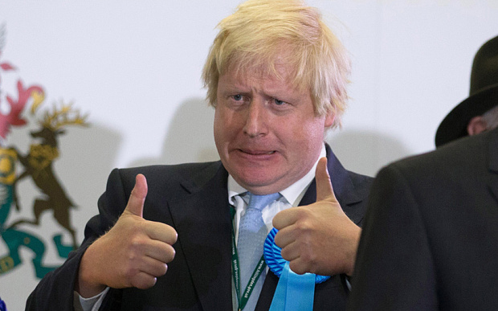
Methodology
Jointly clustering connectivity and content

Slide 11
Classification vs. Clustering
?
A
A
B
B
?
A
A
B
B
A
A
B
B
✓Infers the label of political orientation
✓ Infers the groups/ gatherings

Slide 12
Classification vs. Clustering
?
A
A
B
B
?
A
A
B
B
A
A
B
B
✓Infers the label of political orientation
✗Does not fit into flip flop nature of politics
✓ Infers the groups/ gatherings
✓ Handles dynamic nature of politics

Slide 13
Classification vs. Clustering
?
A
A
B
B
?
A
A
B
B
A
A
B
B
✓Infers the label of political orientation
✗Does not fit into flip flop nature of politics
✗Hard to find labelled data
✓ Infers the groups/ gatherings
✓ Handles dynamic nature of politics
✓ Captures latent structures

Slide 14
What is Novel about our Work?
Taking different types of user interactions into consideration separately
RT unedited, RT edited, Mention

Slide 15
What is Novel about our Work?
Taking different types of user interactions into consideration separately
RT unedited, RT edited, Mention
Applying social theory to Twitter context.

Slide 16
What is Novel about our Work?
Taking different types of user interactions into consideration separately
RT unedited, RT edited, Mention
Applying social theory to Twitter context.
Taking different types of user content into consideration separately;
word, #hashtag, URL

Slide 17
What is Novel about our Work?
Taking different types of user interactions into consideration separately
RT unedited, RT edited, Mention
Applying social theory to Twitter context.
Taking different types of user content into consideration separately;
word, #hashtag, URL

Slide 18
CONNECTIVITY

Slide 19
User Connectivity Network
Minimize cross group edges, maximize inner group edges.

Slide 20
User Connectivity Network
Minimize cross group edges, maximize inner group edges.
RT unedited, RT edited, Mention

Slide 21
User Connectivity Network
Minimize cross group edges, maximize inner group edges.
RT unedited, RT edited, Mention
may imply endorsement
(+)

Slide 22
User Connectivity Network
Minimize cross group edges, maximize inner group edges.
RT unedited, RT edited, Mention
may imply endorsement
(+)
[may] or [may not] imply endorsement
+/-

Slide 23
User Connectivity Network
Minimize cross group edges, maximize inner group edges.
RT unedited, RT edited, Mention
may imply endorsement
[may] or [may not] imply endorsement
+/-
may imply endorsement
(+)
To follow the 1st objective, we need to stick to the positive edges.

Slide 24
User Connectivity Network
Minimize cross group edges, maximize inner group edges.
RT unedited, RT edited, Mention
?
may imply endorsement
[may] or [may not] imply endorsement
+/-
may imply endorsement
(+)
To follow the 1st objective, we need to stick to the positive edges.

Slide 25
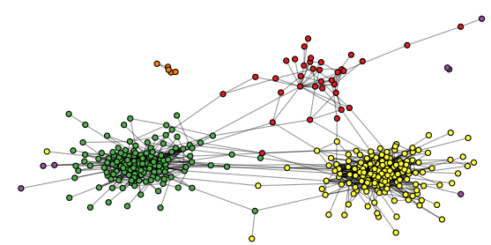
Retweet Unedited Network

Slide 26
Retweet Unedited Network
Output of Gephi forceatlas network visualization.

Slide 27
Retweet Unedited Network
Each color represents a given political orientation

Slide 28
Retweet Unedited Network
Retweets without edits imply endorsement!
Modular Structure!

Slide 29
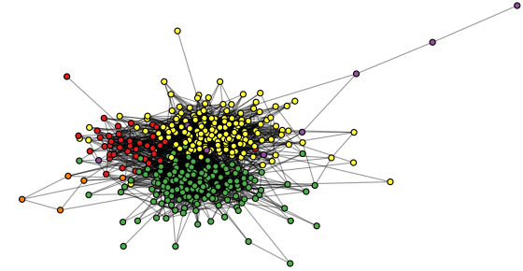
RT edited + Mention Network
?

Slide 30
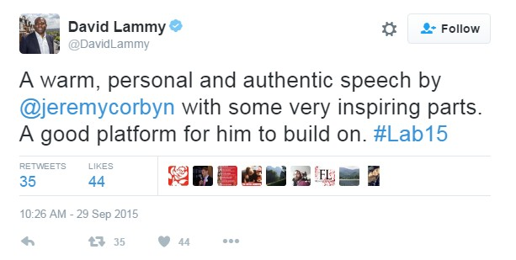
RT edited + Mention Network

Slide 31
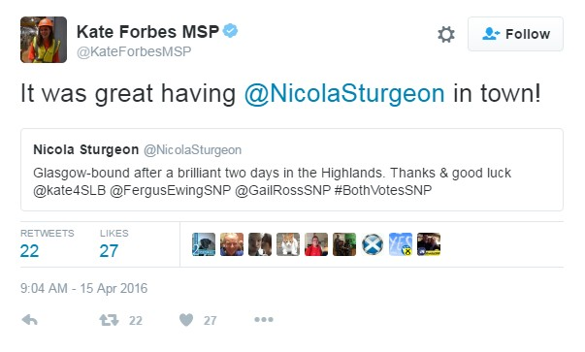
RT edited + Mention Network

Slide 32
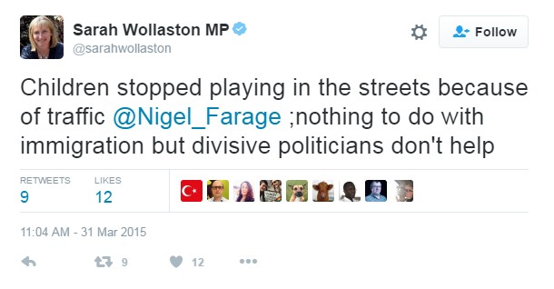
RT edited + Mention Network

Slide 33
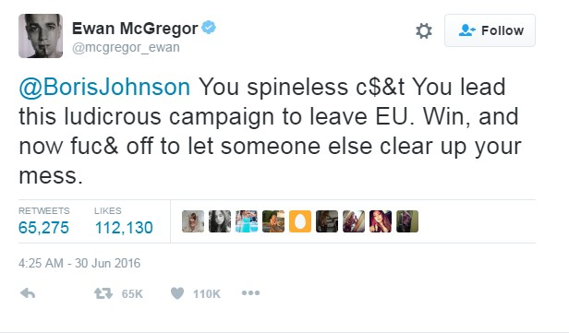
RT edited + Mention Network

Slide 34
RT edited + Mention Network
How to pick positives?

Slide 35
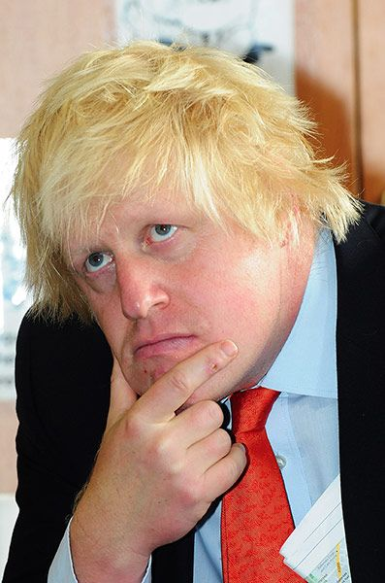
RT edited + Mention Network
How to pick positives?

Slide 36
What is Novel about our Work?
Taking different types of user interactions into consideration separately;
Retweet, Mention, Reply
Applying social theory to Twitter context.
Taking different types of user content into consideration separately;
word, #hashtag, URL

Slide 37
RT edited + Mention Network
How to pick positives?
Heider’s structural balance theory!

Slide 38
Heider’s Structural Balance Theory
Retweet without edit
(+)

Slide 39
Heider’s Structural Balance Theory
Retweet without edit
(+)
(+)

Slide 40
Heider’s Structural Balance Theory
Retweet without edit
Mention
Retweet with edit
(+)
(+)
or
?

Slide 41
Heider’s Structural Balance Theory
Retweet without edit
Mention
Positive Mention
Retweet with edit
(+)
(+)
(+)
(+)
or
?
(+)

Slide 42
Heider’s Structural Balance Theory
Retweet without edit
Mention
Positive Mention
Retweet with edit
(+)
(+)
(+)
(+)
or
?
(+)

Slide 43
Heider’s Structural Balance Theory
Retweet without edit
Mention
Positive Mention
Retweet with edit
Friend of my friend is my friend!
(+)
(+)
(+)
(+)
or
?
(+)

Slide 44
How many hops?

Slide 45
How many hops?
2?
(+)
(+)
or

Slide 46
How many hops?
2?
(+)
(+)
or

Slide 47
How many hops?
2?
(+)
(+)
or

Slide 48
How many hops?
3?
(+)
(+)
(+)
or

Slide 49
How many hops?
(+)
(+)
4?
(+)
(+)
or

Slide 50
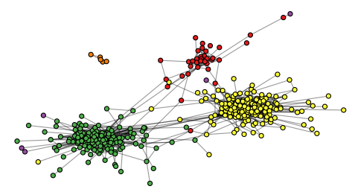
1-Hop Mentions
$$∆Mention= 𝕀_{Retweet}(Mention)$$
$$Retweet$$
$$∆Mention$$

Slide 51
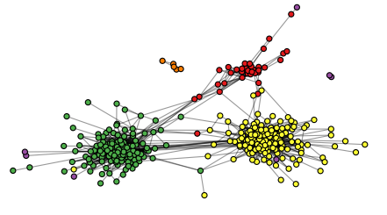
2-Hop Mentions
$$∆M= {𝕀_{Retweet}(M)∪𝕀}_{Retweet^{2}}(M)$$
$$Retweet$$
$$∆Mention$$

Slide 52
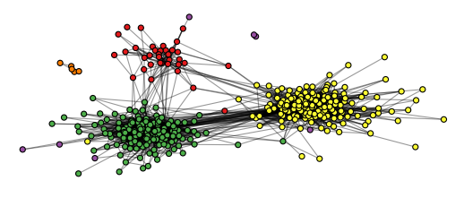
3-Hop Mentions
$$∆M= {𝕀_{R}(M)∪𝕀}_{R^{2}}(M){∪𝕀}_{R^{3}}(M)$$
$$Retweet$$
$$∆Mention$$

Slide 53
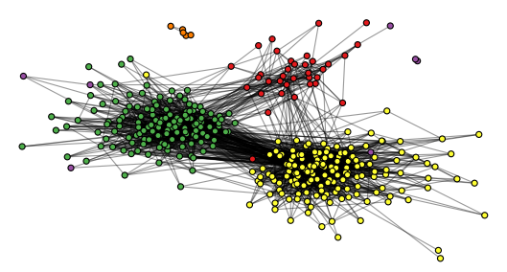
4-Hop Mentions
$$∆M= {𝕀_{R}(M)∪ 𝕀}_{R^{2}}(M){∪𝕀}_{R^{3}}(M){∪𝕀}_{R^{4}}(M)$$
$$Retweet$$
$$∆Mention$$

Slide 54
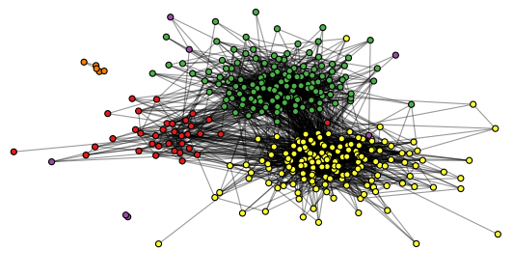
5-Hop Mentions
…
$$Retweet$$
$$∆Mention$$

Slide 55
2-Hop Mentions
$$∆M= {𝕀_{Retweet}(M)∪𝕀}_{Retweet^{2}}(M)$$
$$Retweet$$
$$∆Mention$$

Slide 56
2-Hop Mentions
$$∆M= {𝕀_{Retweet}(M)∪𝕀}_{Retweet^{2}}(M)$$
$$Retweet$$
$$∆Mention$$
Endorsement Filtered Mention Network

Slide 57
Novelty
Taking different types of user interactions into consideration separately;
Retweet, Mention, Reply
Applying social theory to Twitter context.
Taking different types of user content into consideration separately;
word, #hashtag, URL

Slide 58
CONTENT

Slide 59
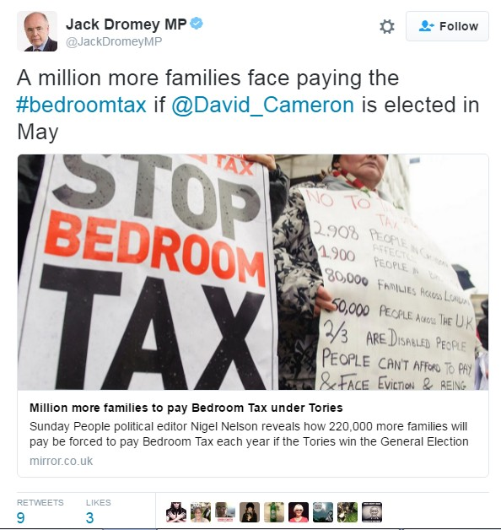
Content Matters

Slide 60
Content Matters – Words
million
.
.
more
.
.
families
.
face
.
paying
elected
.
.
may
.
1
.
.
1
.
.
1
.
1
.
1
1
.
.
1
.

Slide 61
Content Matters – Hashtags
million
.
.
more
.
.
families
.
face
.
paying
elected
.
.
may
.
1
.
.
1
.
.
1
.
1
.
1
1
.
.
1
.
partisan hashtag about Welfare Reform Act 2012

Slide 62
Content Matters – Url Domains
million
.
.
more
.
.
families
.
face
.
paying
elected
.
.
may
.
1
.
.
1
.
.
1
.
1
.
1
1
.
.
1
.
partisan hashtag about Welfare Reform Act 2012
mirror.co.uk
Link to newspaper
Daily Mirror
domain aligned with
Labour Party

Slide 63
PROPOSED METHODS

Slide 64
Proposed Methods
Three nonnegative matrix factorization frameworks

Slide 65
Proposed Methods
Three nonnegative matrix factorization frameworks
user connectivity

Slide 66
Proposed Methods
Three nonnegative matrix factorization frameworks
user connectivity
three dimensions of contents (Word, Hashtag, Domain)

Slide 67
Proposed Methods
Three nonnegative matrix factorization frameworks
user connectivity
three dimensions of contents (Word, Hashtag, Domain)
million
more
paying
families
$$=\left[\begin{matrix} & & & & & \\ & & & & & \\ ⋯ & 6 & 35 & 10 & ⋯ & 7 \\ & & & & & \\ & & & & & \\ & & & & & \\ & & & & & \\ & & & & & \end{matrix}\right]$$
$$X_{uw}$$
User x Word

Slide 68
Proposed Methods
Three nonnegative matrix factorization frameworks
user connectivity
three dimensions of contents (Word, Hashtag, Domain)
families
#bedroomtax
million
more
paying
$$=\left[\begin{matrix} & & & & & \\ & & & & & \\ ⋯ & 6 & 35 & 10 & ⋯ & 7 \\ & & & & & \\ & & & & & \\ & & & & & \\ & & & & & \\ & & & & & \end{matrix}\right]$$
$$=\left[\begin{matrix} & & & & & \\ & & & & & \\ ⋯ & 0 & ⋯ & 10 & ⋯ & 3 \\ & & & & & \\ & & & & & \\ & & & & & \\ & & & & & \\ & & & & & \end{matrix}\right]$$
$$X_{uw}$$
$$X_{uh}$$
User x Word
User x Hashtag

Slide 69
Proposed Methods
Three nonnegative matrix factorization frameworks
user connectivity
three dimensions of contents (Word, Hashtag, Domain)
families
#bedroomtax
mirror.co.uk
million
more
paying
$$=\left[\begin{matrix} & & & & & \\ & & & & & \\ ⋯ & 6 & 35 & 10 & ⋯ & 7 \\ & & & & & \\ & & & & & \\ & & & & & \\ & & & & & \\ & & & & & \end{matrix}\right]$$
$$=\left[\begin{matrix} & & & & & \\ & & & & & \\ ⋯ & 0 & ⋯ & 10 & ⋯ & 3 \\ & & & & & \\ & & & & & \\ & & & & & \\ & & & & & \\ & & & & & \end{matrix}\right]$$
$$=\left[\begin{matrix} & & & & & \\ & & & & & \\ ⋯ & 5 & ⋯ & 57 & ⋯ & 0 \\ & & & & & \\ & & & & & \\ & & & & & \\ & & & & & \\ & & & & & \end{matrix}\right]$$
$$X_{uw}$$
$$X_{uh}$$
$$X_{ud}$$
User x Word
User x Hashtag
User x Domain

Slide 70
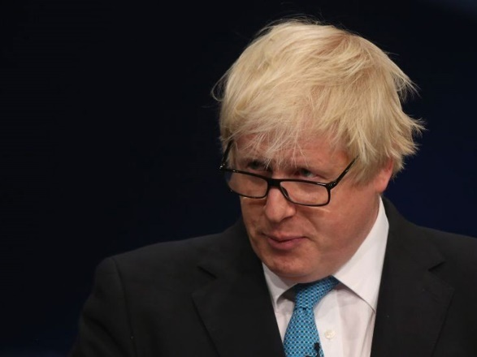
Proposed Methods
Objective Function

Slide 71
Matrix Factorization
Objective Function

Slide 72
Matrix Factorization
Objective Function
$$X_{uw}$$
$$U$$
X
$$W^{T}$$
$$≈$$
cluster x word
user x word
user x cluster

Slide 73
Matrix Factorization
Objective Function
$$X_{uh}$$
$$U$$
X
$$H^{T}$$
$$≈$$
cluster x hashtag
user x hashtag
user x cluster

Slide 74
Matrix Factorization
Objective Function
$$X_{uh}$$
$$U$$
X
$$H^{T}$$
$$≈$$
cluster x hashtag
user x hashtag
user x cluster

Slide 75
Matrix Factorization
Objective Function
$$X_{ud}$$
$$U$$
X
$$D^{T}$$
$$≈$$
cluster x domain
user x domain
user x cluster

Slide 76
Proposed Methods
Objective Function

Slide 77
Regularization
Objective Function

Slide 78
Regularization
User Network

Slide 79
Regularization
User Network
Hashtag
Co-Occurrence Matrix

Slide 80
Regularization
User Network
Hashtag
Co-Occurrence Matrix
Domain & Word
Cosine Similarity Matrix

Slide 81
Nonnegativity Constraints
Objective Function

Slide 82
Proposed Methods
To use only two or one dimension of the content, simply omit unrelated terms;

Slide 83
Proposed Methods
To use only two or one dimension of the content, simply omit unrelated terms;

Slide 84
Proposed Methods
To use only two or one dimension of the content, simply omit unrelated terms;
MultiNMF

Slide 85
Proposed Methods
To use only two or one dimension of the content, simply omit unrelated terms;
TriNMF

Slide 86
Proposed Methods
To use only two or one dimension of the content, simply omit unrelated terms;
DualNMF

Slide 87
Proposed Methods
MultiNMF
+ #hashtag + URL domains + words

Slide 88
Proposed Methods
MultiNMF
+ #hashtag + URL domains + words
TriNMF
+ #hashtag + words

Slide 89
Proposed Methods
MultiNMF
+ #hashtag + URL domains + words
TriNMF
+ URL domains + words

Slide 90
Proposed Methods
MultiNMF
+ #hashtag + URL domains + words
TriNMF
+ [ #hashtag or URL domains ] + words
DualNMF
+ words

Slide 91
Proposed Methods
MultiNMF
+ #hashtag + URL domains + words
+ content co-occurrence and similarity regularizers
TriNMF
+ [ #hashtag or URL domains ] + words
+ content co-occurrence and similarity regularizers
DualNMF
+ words
+ content similarity regularizer

Slide 92
DATA DESCRIPTION & EXPERIMENTAL RESULTS

Slide 93
Data Description
United Kingdom | Ireland
419 Members of Parliament (MPs) | 348 Irish politicians
5 Ground Truth Groups (political parties) | 7 Disjoint Political Groups

Slide 94
Data Description
United Kingdom | Ireland
419 Members of Parliament (MPs) | 348 Irish politicians
5 Ground Truth Groups (political parties) | 7 Disjoint Political Groups
1,077,437 tweets | 548,424 tweets
63,598 hashtags | 51,854 hashtags
8,200 domains | 7,372 domains

Slide 95
Preprocessing
United Kingdom | Ireland
419 Members of Parliament (MPs) | 348 Irish politicians
5 Ground Truth Groups (political parties) | 7 Disjoint Political Groups
1,077,437 tweets | 548,424 tweets
63,598 hashtags | 51,854 hashtags
8,200 domains | 7,372 domains
Pick latest 200 tweets before 2015
Pick latest 200 tweets before 2015

Slide 96
Preprocessing
United Kingdom | Ireland
419 Members of Parliament (MPs) | 348 Irish politicians
5 Ground Truth Groups (political parties) | 7 Disjoint Political Groups
1,077,437 tweets | 548,424 tweets
63,598 hashtags | 51,854 hashtags
8,200 domains | 7,372 domains
Pick latest 200 tweets before 2015
Pick latest 200 tweets before 2015
Eliminate words appear < 20
Eliminate words appear < 20

Slide 97
Preprocessing
United Kingdom | Ireland
419 Members of Parliament (MPs) | 348 Irish politicians
5 Ground Truth Groups (political parties) | 7 Disjoint Political Groups
1,077,437 tweets | 548,424 tweets
63,598 hashtags | 51,854 hashtags
8,200 domains | 7,372 domains
Pick latest 200 tweets before 2015
Pick latest 200 tweets before 2015
Eliminate words appear < 20
Eliminate words appear < 20
Eliminate #tags & domains
< 2
Eliminate #tags & domains
< 2

Slide 98
Preprocessing
United Kingdom | Ireland
419 Members of Parliament (MPs) | 348 Irish politicians
5 Ground Truth Groups (political parties) | 7 Disjoint Political Groups
1,077,437 tweets | 548,424 tweets
63,598 hashtags | 51,854 hashtags
8,200 domains | 7,372 domains
Pick latest 200 tweets before 2015
Pick latest 200 tweets before 2015
Eliminate words appear < 20
Eliminate words appear < 20
Eliminate #tags & domains
< 2
Eliminate #tags & domains
< 2

Slide 99
Preprocessing
United Kingdom | Ireland
419 Members of Parliament (MPs) | 348 Irish politicians
5 Ground Truth Groups (political parties) | 7 Disjoint Political Groups
19,947 tweets | 14,656 tweets
945 hashtags | 986 hashtags
946 domains | 634 domains
Pick latest 200 tweets before 2015
Pick latest 200 tweets before 2015
Eliminate words appear < 20
Eliminate words appear < 20
Eliminate #tags & domains
< 2
Eliminate #tags & domains
< 2

Slide 100
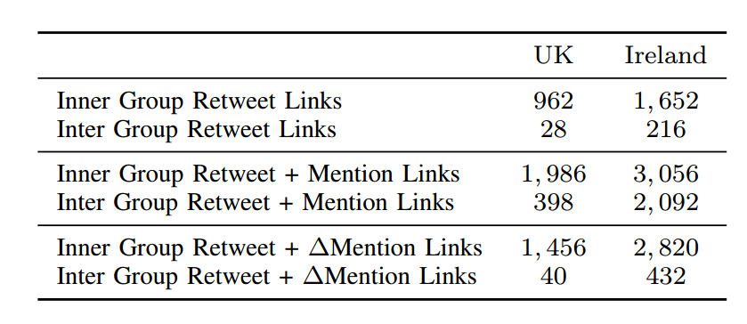
Only Connectivity Results

Slide 101
Experimental Results

Slide 102
Only Connectivity Results
Mention Network
Retweet Network
Endorsement Filtered
Mention Network

Slide 103
Only Connectivity Results
Mention Network
$$R+M$$
Retweet Network
Endorsement Filtered
Mention Network
$$R+∆M$$
$$R+∆M_{w}$$

Slide 104
Only Connectivity Results
United Kingdom | Ireland

Slide 105
Only Connectivity Results
United Kingdom | Ireland
Trend of Increase

Slide 106
Only Connectivity Results
United Kingdom | Ireland
☺
High Accuracies

Slide 107
Only Connectivity Results
United Kingdom | Ireland
☹
Artificially Large Number of Clusters

Slide 108
Only Connectivity Results
United Kingdom | Ireland
☹
Artificially Large Number of Clusters
Ground Truth: 5
Ground Truth: 7

Slide 109
Connectivity & Content Results

Slide 110
Connectivity & Content Results United Kingdom

Slide 111
Connectivity & Content Results

Slide 112
Connectivity & Content Results
Best Accuracy: DualNMF

Slide 113
Connectivity & Content Results
Latest Similar Work* in IJCAI’15
9% more purity
46% more ARI
doubles NMI!

Slide 114
Connectivity & Content Results

Slide 115
Connectivity & Content Results
Hashtag
?
Domain

Slide 116
Connectivity & Content Results
Hashtag <
Domain

Slide 117
Connectivity & Content Results

Slide 118
Connectivity & Content Results
Descriptive power of user graph

Slide 119
Connectivity & Content Results Ireland

Slide 120
Connectivity & Content Results

Slide 121
Connectivity & Content Results
Best Accuracy: DualNMF

Slide 122
Connectivity & Content Results
Latest Similar Work* in IJCAI’15
Best Accuracy: DualNMF

Slide 123
Connectivity & Content Results
Hashtag
?
Domain

Slide 124
Connectivity & Content Results
Hashtag ≈
Domain

Slide 125
Connectivity & Content Results
Hashtag ≈
Domain

Slide 126
Connectivity & Content Results
Descriptive power of user graph

Slide 127
Discussion
Political orientation in Twitter;

Slide 128
Discussion
Political orientation in Twitter;
interaction with others

Slide 129
Discussion
Political orientation in Twitter;
interaction with others
word usage
how words used by others

Slide 130
Discussion
Political orientation in Twitter;
interaction with others
word usage
how words used by others
Incorporating further content;
posted URL domains
hashtag usage

Slide 131
Discussion
Political orientation in Twitter;
interaction with others
word usage
how words used by others
Incorporating further content;
posted URL domains
hashtag usage
meh…
😐

Slide 132
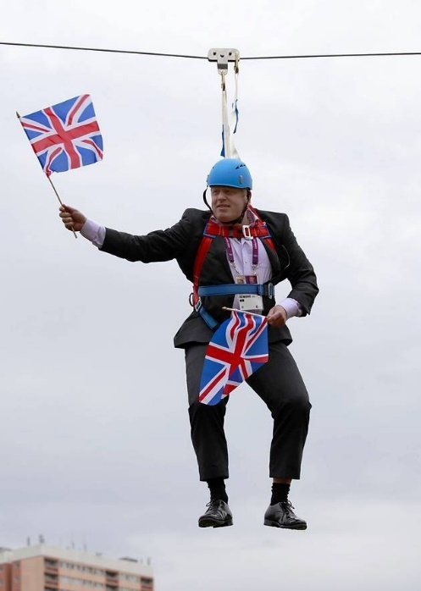
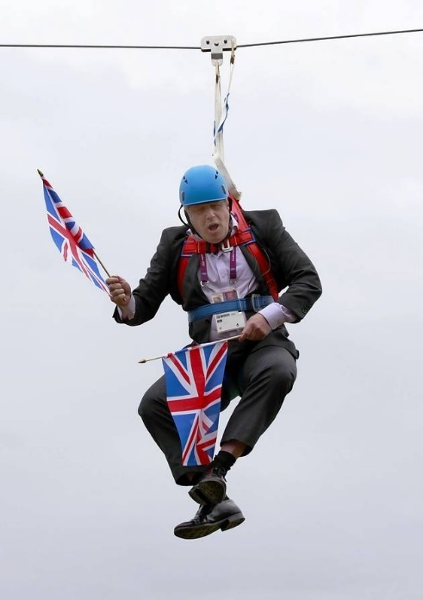
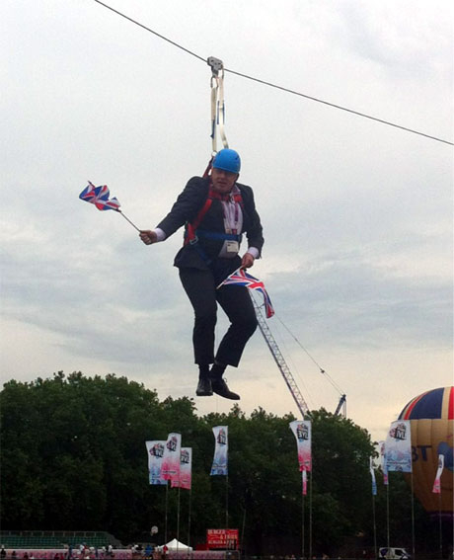
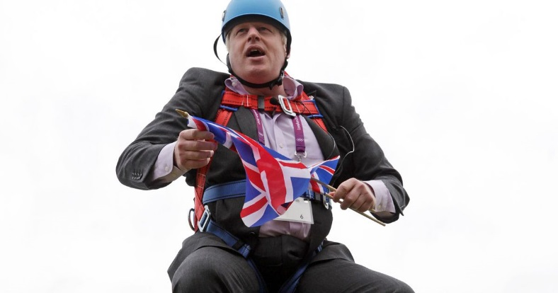
Any Questions?

